Slide 1

Data Mining How IBM can reduce employees' attrition?
Álvaro Tapia Ivan Nemtsev José Ramon Cobos Carlos Ramírez Niccolò Guerzoni Panichi

Slide 2
Outline
Business Goal
Data Mining Goal
Data Description
Data Preparation
Methods
Evaluation
Recommendations

Slide 3
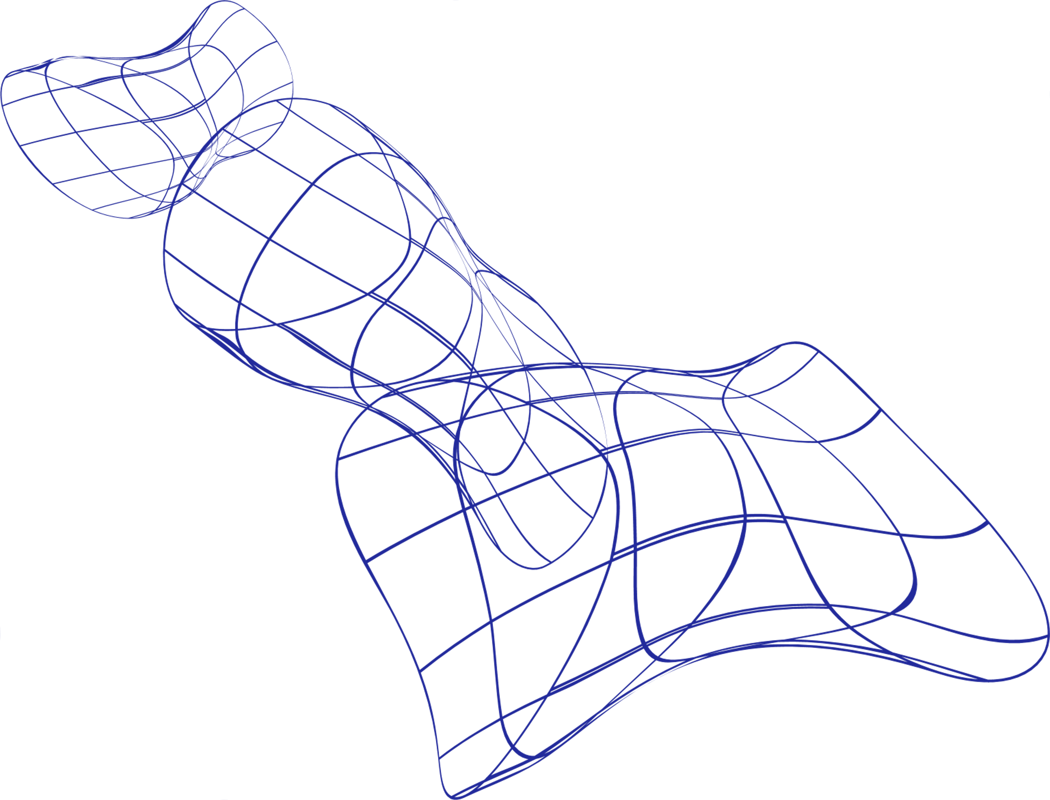
Business Problem
Attrition: act of weakening or exhausting in the work environment.
(Merriam-Webster, 2022)
Study 40% of employees are likely to resign in the next 3 – 6 months.
(McKinsey, 2021)
IBM gathered data from + 1,400 employees and factors leading to attrition.
Problem? Companies invest millions U.S. dollars in training and talent retention.
Voluntary downsizing harms a Company's development and performance.

Slide 4


Slide 5
Business goal
Understand main factors of attrition and evaluate those.
Seek ways to improve employees' welfare.
Retention Efficiency
Benefits: smart hiring/training decisions

Slide 6
Data Mining Goal
Explaining factors that lead to attrition
Predicting which employee may suffer attrition
Explaining different WEIGHTS of the variables in the model.
Applying the model to catalog employees as "at risk of suffering attrition" or not.
DESCRIPTIVE
PREDICTIVE
We do not want somebody at risk of leaving being cataloged as not at risk

Slide 7
Data description
Source Kaggle
Dimensions 35 x 1470
Author IBM data scientists
Data Attrition

Slide 8
Data preparation
Check for "unknown" observations
Create dummy variables
Delete unnecessary variables
Divide data into training/validation set
Normalize data

Slide 9
Methods
Multiple Linear Regression
Neuronal Network
Decision Tree
XGBoost

Slide 10
Evaluation
1) Linear Regression
Adjusted R-squared: 0.1919
Problems:
Low accuracy
Same weight for all the variables
Limited model

Slide 11
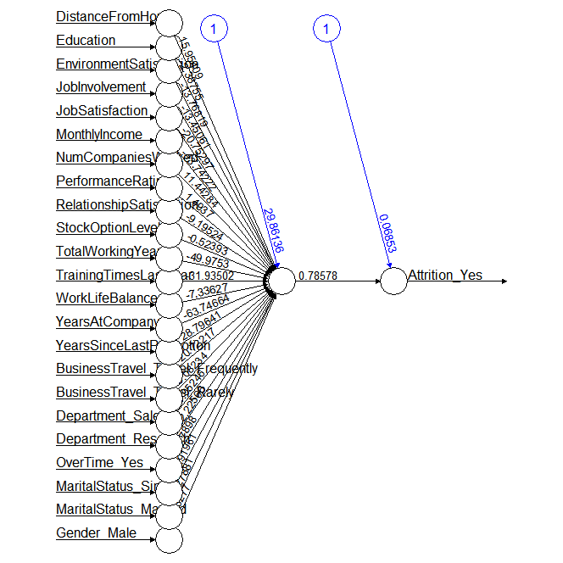
Evaluation
2) Neuronal network
Training: 0.2809806
Validation: 0.3455202
RMSE
Accuracy: 65.5%

Slide 12
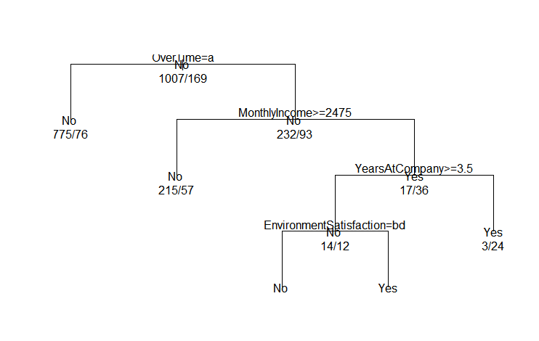
Evaluation
3) Decision Tree
Actual Values/ Prediction | NO | YES
NO | 221 | 54
YES | 5 | 14
Accuracy : 0.7993

Slide 13
Evaluation
4) XGBoost
Actual Values/ Prediction | NO | YES
NO | 222 | 4
YES | 52 | 16
Accuracy : 0.8095

Slide 14
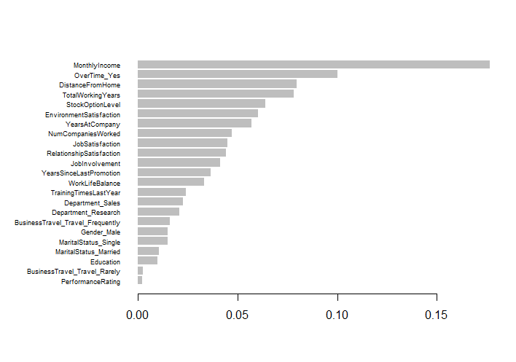
4) XGBoost
Evaluation

Slide 15
Propose model
Model: XGBoost, 79.25% accuracy
Variables:
Monthly income
Over time
Distance from home
Total year working
Stock option

Slide 16

Competitive salary ranges
Reduce overload time
Distance from home
Reward long-lasting employees
Stimulate with stock options
Recommendations

Slide 17

Reference List
1. McKinsey, 8 Sep 2021, ‘Great Attrition’ or ‘Great Attraction’? The choice is yours https://www.mckinsey.com/capabilities/people-and-organizational-performance/our-insights/great-attrition-or-great-attraction-the-choice-is-yours
2. Paul Chance, 27 Jan 2021, 'Why Is Attrition Becoming an Increasing Problem?' https://www.callcentrehelper.com/attrition-problem-167212.htm
3. Merriam webster.....

